Slide 1
03 | Operationalize end-to-end Cloud Analytics Solutions
Venks Mantha | Data Solution Architect, NY Metro
Gaurav Malhotra | Sr. Program Manager, Data Factory

Slide 2
Setting Expectations
Target Audience
Any “data” person with some technical background
CSA, DSA, DPSA, Architect, Consultant, PFE, TSP, TAM
Suggested Prerequisites/Supporting Material
CRT307-TR23 by Lou Carbone
Objectives
Key Takeaways
Preparation
Reading & Doing
Yes, some Memorization is required

Slide 3
Setting Expectations Continued …
Key Takeaways
Focused information to help you prepare for the exam
Module where almost all the content is tied to one service – Azure Data Factory
Content can be used to learn, prepare and DEMO Data Factory for your customers
Hands-on is a MUST for this module

Slide 4
In this module
Data Factory Overview & Concepts
Data Factory Operations
Data Factory Monitoring & Management
Data Factory Extensions
Data Factory – Roadmap

Slide 5
In this module
Data Factory Overview & Concepts
Data Factory Operations
Data Factory Monitoring & Management
Data Factory Extensions
Data Factory – Roadmap

Slide 6
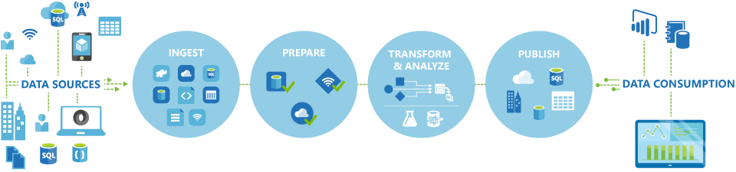
Azure Data Factory
A managed cloud service for building & operating data pipelines
Command & Control
Not Compute and Store
Part of the Cortana Intelligence Suite

Slide 7
Azure Data Factory
OPERATIONALIZE BATCH PIPELINES
Orchestrate | Schedule | Monitor | Manage
CONTINUOUS ITERATIONS →

Slide 8
Why Data Factory?
Orchestrate, schedule, monitor & manage data pipelines
Compose data processing, storage, and movement services (on-premises and cloud)
Operate on a recurring schedule
Automatic cloud resource management
Globally available data movement capability
Intelligent job-based resource management
Single pane of glass
One place to manage and monitor data pipelines

Slide 9
Data Factory Concepts
Data Factory (Top Level Object)
Data Sources, Linked Services & Datasets
Activities
Pipelines
Notes:
Data Factory <--> JSON
Data Interchange Format/Language

Slide 10
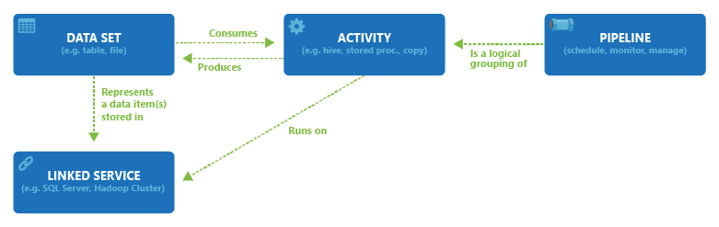
Data Sources, Linked Services & Datasets

Slide 11
Activities

Slide 12
Pipelines

Slide 13
Data Sets
A Pointer to the data to be processed
Data Set
Definition
Type
Structure
Availability
Policy
External & Scoped Datasets
Notes:
Please read and understand the data set link

Slide 14
Data Set Structure
{
"name": "<name of dataset>",
"properties": {
"type": "<type of dataset: AzureBlob, AzureSql etc...>",
"external": <boolean flag to indicate external data. only for input datasets>,
"linkedServiceName": "<Name of the linked service that refers to a data store.>",
"structure": [
{
"name": "<Name of the column>",
"type": "<Name of the type>"
}
],
"typeProperties": {
"<type specific property>": "<value>",
"<type specific property 2>": "<value 2>",
},
"availability": {
"frequency":
"<Specifies the time unit for data slice production. Supported frequency: Minute, Hour, Day, Week, Month>",
"interval":
"<Specifies the interval within the defined frequency.
For example, frequency set to 'Hour' and interval set to 1 indicates that new data slices should be produced hourly>"
},
"policy":
{
}
}
}

Slide 15
Data Set Structure - Example
Data Set
Linked Service
{
"name": "DatasetSample",
"properties": {
"type": "AzureSqlTable",
"linkedServiceName": "AzureSqlLinkedService",
"typeProperties":
{
"tableName": "MyTable"
},
"availability":
{
"frequency": "Day",
"interval": 1
}
}
}
{
"name": "AzureSqlLinkedService",
"properties": {
"type": "AzureSqlDatabase",
"description": "",
"typeProperties": {
"connectionString": "Data Source=tcp:<servername>.database.windows.net,1433;Initial Catalog=<databasename>;User ID=<username>@<servername>;Password=<password>;Integrated Security=False;Encrypt=True;Connect Timeout=30"
}
}
}

Slide 16
Pipelines & Activities
A Logical grouping of Activities
To perform a task
Active only between Start Time and End Time
Activities in the pipeline are the ones that get executed (not pipeline itself, logical)
An Activity is the “unit” of Orchestration in Data Factory
An Action to perform on data
Zero or more data sets as input producing one or more output data sets.
Structure
Anatomy of a pipeline
Activities section of a pipeline
Policies

Slide 17
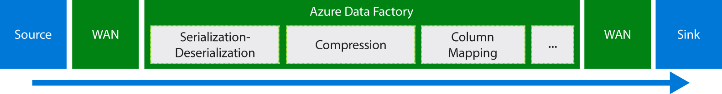
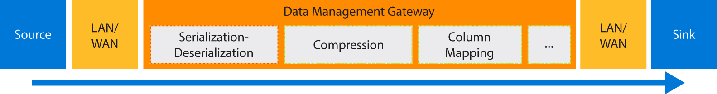
Data Migration
Cloud to Cloud
On-premise to Cloud

Slide 18
Activity Types
Data Movement Activities
Moves data between supported data stores
Data Transformation Activities
Process data using computes

Slide 19
Data Movement - Supported Data Stores and Formats
Category | Data store | Supported as a source | Supported as a sink
Azure | Azure Blob storage Azure Data Lake Store Azure SQL Database Azure SQL Data Warehouse Azure Table storage Azure DocumentDB | ✓ ✓ ✓ ✓ ✓ ✓ | ✓ ✓ ✓ ✓ ✓ ✓
Databases | SQL Server* Oracle* MySQL* DB2* Teradata* PostgreSQL* Sybase* Cassandra* MongoDB* Amazon Redshift | ✓ ✓ ✓ ✓ ✓ ✓ ✓ ✓ ✓ ✓ | ✓ ✓
File | File System* HDFS* Amazon S3 | ✓ ✓ ✓ | ✓
Others | Salesforce Generic ODBC* Generic OData Web Table (table from HTML) GE Historian* | ✓ ✓ ✓

Slide 20
Data Transformation - Supported Activity Types
Data transformation activity | Compute environment
Hive | HDInsight [Hadoop]
Pig | HDInsight [Hadoop]
MapReduce | HDInsight [Hadoop]
Hadoop Streaming | HDInsight [Hadoop]
Machine Learning activities: Batch Execution and Update Resource | Azure VM
Stored Procedure | Azure SQL, Azure SQL Data Warehouse, or SQL Server
Data Lake Analytics U-SQL | Azure Data Lake Analytics
DotNet | HDInsight [Hadoop] or Azure Batch
Two Types of Compute Environment:
On-Demand - Fully managed by data factory
Bring Your Own - Managed by you but registered as linked service

Slide 21
In this module
Data Factory Concepts
Data Factory Operations
Data Factory Monitoring & Management
Data Factory Extensions
Data Factory – Roadmap

Slide 22
DEMO - live
Copy data from Blob Storage to Azure SQL DB using Data Factory

Slide 23
Copy data from Blob Storage to Azure SQL DB Using Data Factory
High Level Steps
Create a Data Factory
Need an Azure Subscription
Create a General Purpose (Not BLOB) Storage Account
Create an Azure SQL DB
Create a Linked Service
Create Input and Output Datasets
Create the Pipeline
Monitor the Pipeline

Slide 24
DEMO
Build a Pipeline to process data using Hadoop Cluster

Slide 25
Build a Pipeline to process data using Hadoop Cluster
High Level Steps
Create a Data Factory
Need an Azure Subscription
Create a General Purpose (Not BLOB) Storage Account
Create a Linked Service
Create Input and Output Datasets
Create the Pipeline
Monitor the Pipeline
Notes:
Sequence is important in most of the things that we do in Data Factory which is operationalizing end-2-end analytical solutions

Slide 26
Scheduling & Execution
Data slice: A unit of data consumed and produced by an activity run
Time series datasets and data slices
Continuous sequence of data points (E.g. sensor data and telemetry data)
Data factory can process time series data in batches

Slide 27
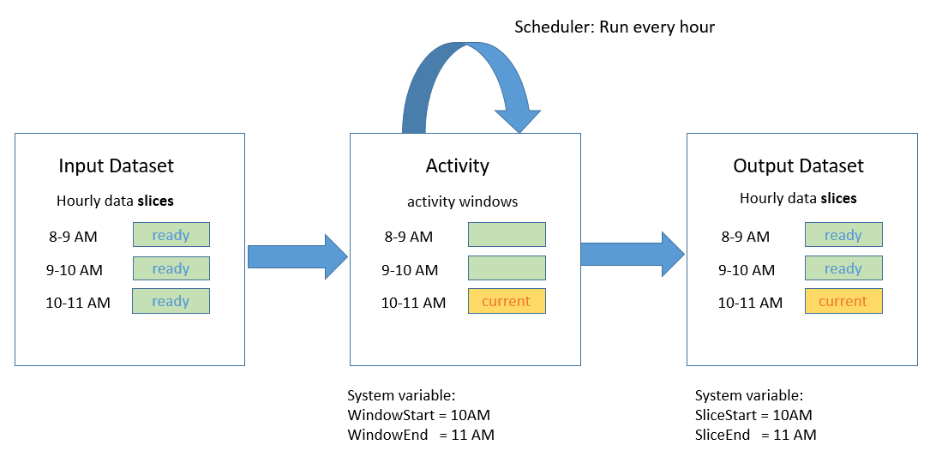
Scheduling & Execution
Example:
"scheduler": {
"frequency": "Hour",
"interval": 1
}
Creates a Series of Tumbling Windows (Activity Windows)
Fixed-size series, non-overlapping and contiguous

Slide 28
Scheduling & Execution
Pipeline has an Active Period defined by Start and End Times
Pipeline Start time can be set to be in the Past
Allows data factory to calculate and back fill data slices
Processing starts immediately
Backfilled data slicers can be run in parallel by using the “Concurrency” Property
Running Activities in a Sequence
Chaining
Second Activity runs ONLY when first activity is finished

Slide 29
Scheduling & Execution
Datasets with Different Frequencies
Expressions
Data Factory Functions
Data Slice Validation
Downstream activity will not execute if prior active is NOT validated
External Data
Data NOT produced by data factory. Set External Property to TRUE
Onetime Pipeline
Set PipelineMode to TRUE

Slide 30
In this module
Data Factory Concepts
Data Factory Operations
Data Factory Monitoring & Management
Data Factory Extensions
Data Factory – Roadmap

Slide 31
Monitoring & Management
Show My Latest Executions, What Failed, What’s Running right now?
Can I Debug, Re-run my failures?
Can I perform Batch actions (bulk pause, resume pipelines etc.)?
Can I raise Alerts on various events (failures etc.)?
Can I configure my monitoring layouts?

Slide 32
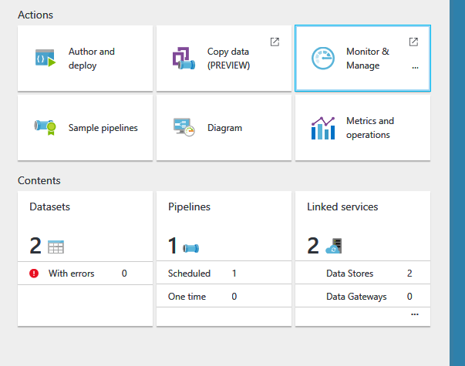

Monitoring & Management

Slide 33
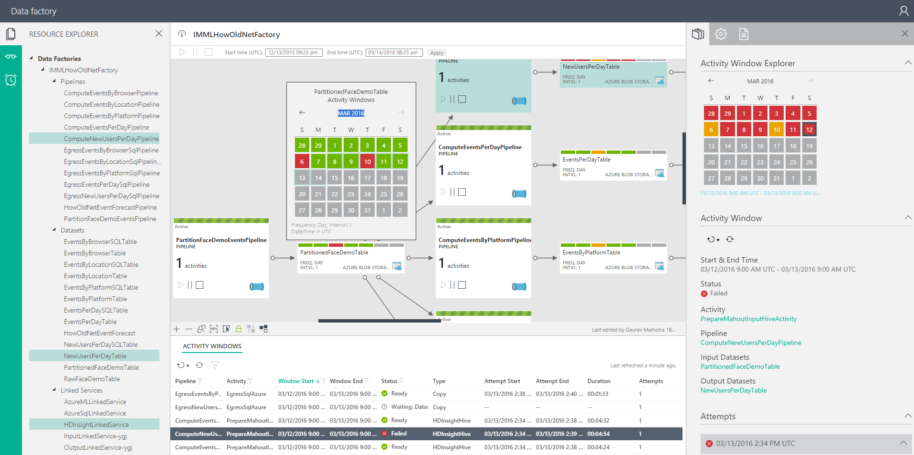
Monitoring & Management App

Slide 34
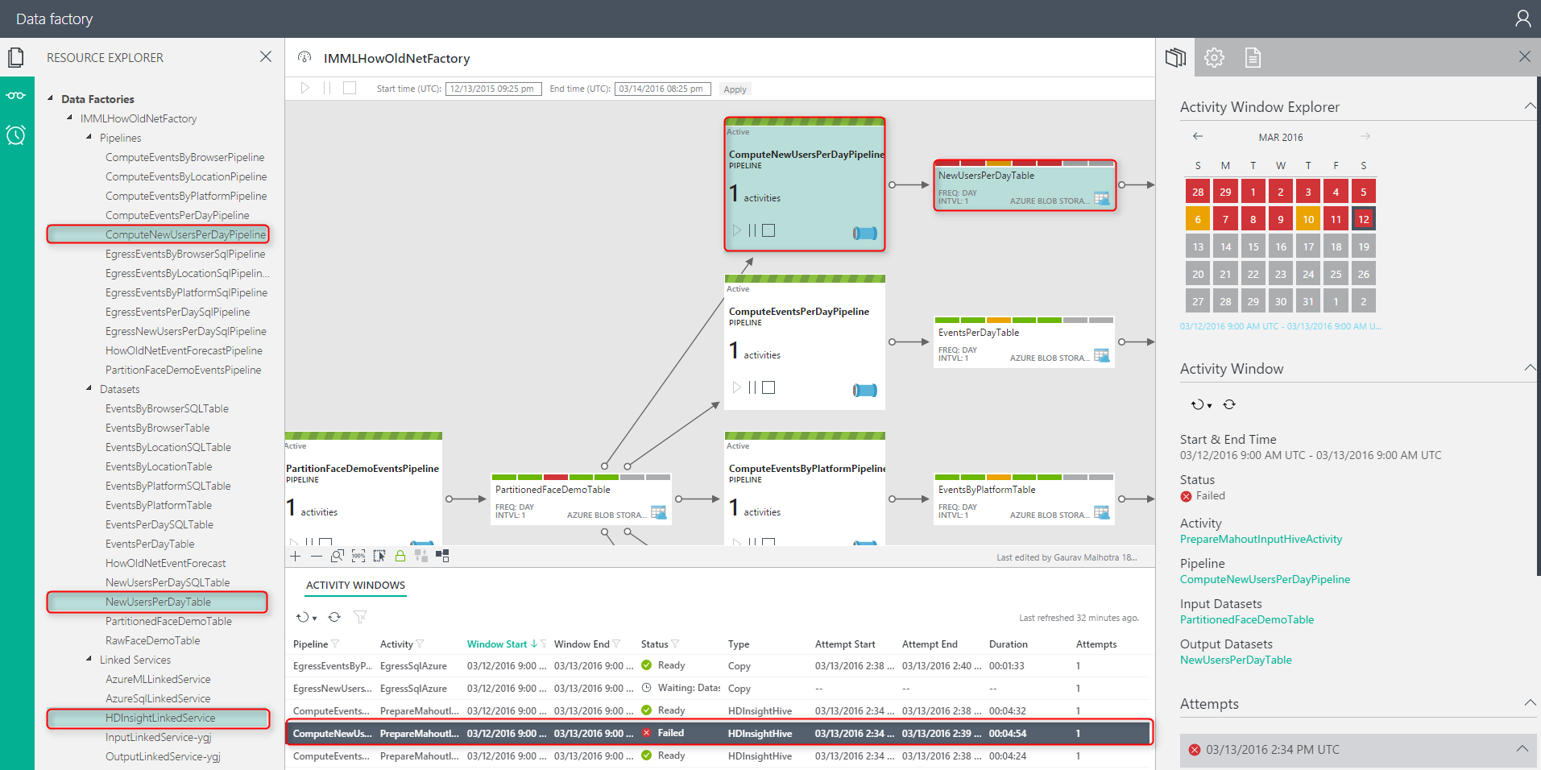
Monitoring & Management App Dense Information with Context

Slide 35
In this module
Data Factory Concepts
Data Factory Operations
Data Factory Monitoring & Management
Data Factory Extensions
Data Factory – Roadmap

Slide 36
Data Factory Extensions - Developer Reference
Method | Resource Location | References
Azure portal | https://portal.azure.com/
Azure PowerShell | Download the latest Azure PowerShell | Cmdlet reference
.NET Class Library | The Azure Data Factory .NET SDK enables you to create, monitor, and manage Azure data factories and extend Data Factory using a .NET activity. See Use custom activities in an Azure Data Factory pipeline and Create, monitor, and manage Azure data factories using Data Factory .NET SDK articles to help you get started. Downloading the latest Nuget You can download the latest Azure Data Factory Management Library Nuget package from: https://www.nuget.org/packages/Microsoft.Azure.Management.DataFactories/ Using Package Manager Console in Visual Studio You can run the following command in Visual Studio’s Package Manager Console to get the latest Azure Data Factory Management Library Install-Package Microsoft.Azure.Management.DataFactories | .NET SDK Reference
REST API | You can use the Data Factory REST API to create, monitor, and manage Azure data factories. | REST API Reference

Slide 37
Data Factory Extensions – Custom Activity
Move data to/from a data store NOT supported by Data Factory
Transform/Process data NOT supported by Data Factory
A .NET Custom Activity with appropriate Logic
Use this activity in a pipeline
Azure Batch Service or HDInsight Cluster is needed to run the custom .NET Activity

Slide 38
Data Factory Extensions – Custom Activity Steps
Create a Custom Activity
Using Visual Studio, create a .NET Class Library Project
Zip all the binary files and upload to Azure Blob Storage
Create an Azure Data Factory
Create Linked Services
Create Input and Output Datasets
Create and Run the Pipeline

Slide 39
In this module
Data Factory Concepts
Data Factory Operations
Data Factory Monitoring & Management
Data Factory Extensions
Data Factory – Roadmap

Slide 40
Data Factory Roadmap
 | Current | Roadmap
Authoring | Web-based editor Visual Studio plug-in (intellisense & pipeline templates) VS 2015 | Drag & Drop authoring Application templates (CAS: customer churn, recommendations, etc.)
Data Movement | Azure storage, Azure Document Db, on-premises: SQL Server, Oracle DB, File Shares, MySQL, Teradata, Azure Document Db, PostgreSQL, DB2, Sybase, Azure SQL DW, Cassandra, MongoDB, Generic ODBC, Generic OData, Salesforce, GE Historian | New Data sources added each month. 40 new connectors in next 3-6 months Public preview: Azure Data Lake Store
Data Production | Azure Machine Learning integration HDInsight enhancements Azure Batch | Additional Activities (Spark etc.) Limited Preview: Azure Data Lake Analytics, HDInsight on Linux Improvements: Data Types, Reference Data
Data Management | Monitoring diagram: lineage views, custom layout “Recently updated datasets” view “Drill down into pipelines” | New M&M App: easy navigation & debugability, system views, filtering, sorting, etc. Enhanced alerting
App Model | Time Series Log Processing | Control Flow (Events, Triggers, Loops)
Geo Location | Note: can orchestrate/schedule/monitor resources in all geo-regions now Globally deployed data movement | Additional geo-regions

Slide 41
Resources
Azure Data Factory
ADF Video 1 https://mva.microsoft.com/en-US/training-courses/orchestrating-data-and-services-with-azure-data-factory-15962
ADF Video 2 https://azure.microsoft.com/en-us/documentation/videos/how-to-monitor--manage-big-data-pipelines-with-azure-data-factory/
Introduction https://azure.microsoft.com/en-us/documentation/articles/data-factory-introduction/
Tutorial 1 https://azure.microsoft.com/en-us/documentation/articles/data-factory-build-your-first-pipeline/
Azure Portal, Visual Studio, Power Shell, ARM Template, REST API
Data Sources https://azure.microsoft.com/en-us/documentation/articles/data-factory-data-movement-activities/
Activity Types https://azure.microsoft.com/en-us/documentation/articles/data-factory-data-transformation-activities/
Data Sets https://azure.microsoft.com/en-us/documentation/articles/data-factory-create-datasets/
Pipelines https://azure.microsoft.com/en-us/documentation/articles/data-factory-create-pipelines/
Schedule/Exec https://azure.microsoft.com/en-us/documentation/articles/data-factory-scheduling-and-execution/
Tutorial 2 https://azure.microsoft.com/en-us/documentation/articles/data-factory-copy-data-from-azure-blob-storage-to-sql-database/
Azure Portal, Visual Studio, Power Shell, REST API, .NET API, Copy Wizard
Tutorial 3 https://azure.microsoft.com/en-us/documentation/articles/data-factory-move-data-between-onprem-and-cloud/
Samples https://azure.microsoft.com/en-us/documentation/articles/data-factory-samples/

Slide 42
Resources Continued …
Learning Path
https://azure.microsoft.com/en-us/documentation/learning-paths/data-factory/
Azure Data Factory Monitor and Manage
https://azure.microsoft.com/en-us/documentation/articles/data-factory-monitor-manage-app/
End-2-End Data Processing Overview
https://blogs.msdn.microsoft.com/data_insights_global_practice/2015/10/23/end-to-end-data-processing-using-azure-data-factory-overview/
Design and Implement Big Data & Analytics Solutions
https://mva.microsoft.com/en-US/training-courses/design-and-implement-big-data-advanced-analytics-solutions-16531?l=bsSKczWdC_7706218965

Slide 43
Copy Blob to SQL DB Steps
https://portal.azure.com
Make sure you are Logged-in
Must have a valid subscription
Create the Blob Storage
Create the SQL DB
SQL Server Management Studio or
Visual Studio

Slide 44
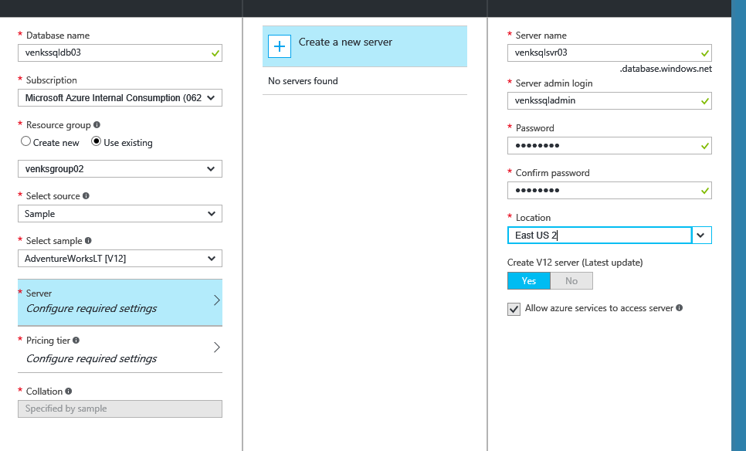
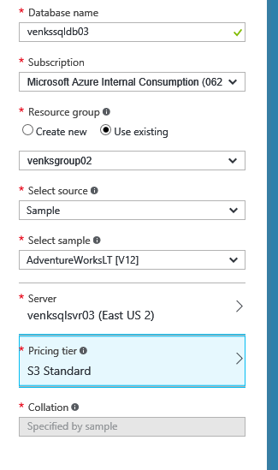
Azure SQL DB Creation

Slide 45
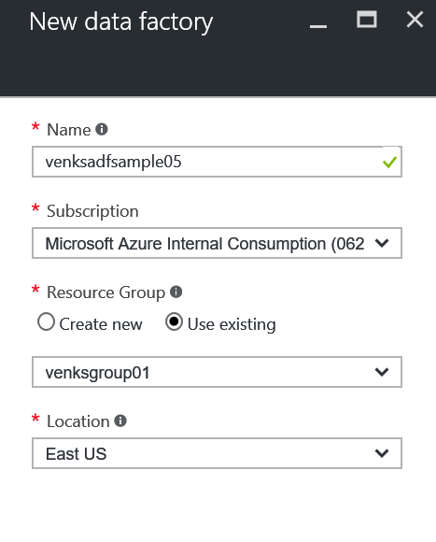
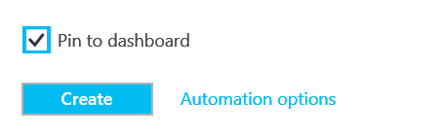
Azure Data Factory - Creation

Slide 46
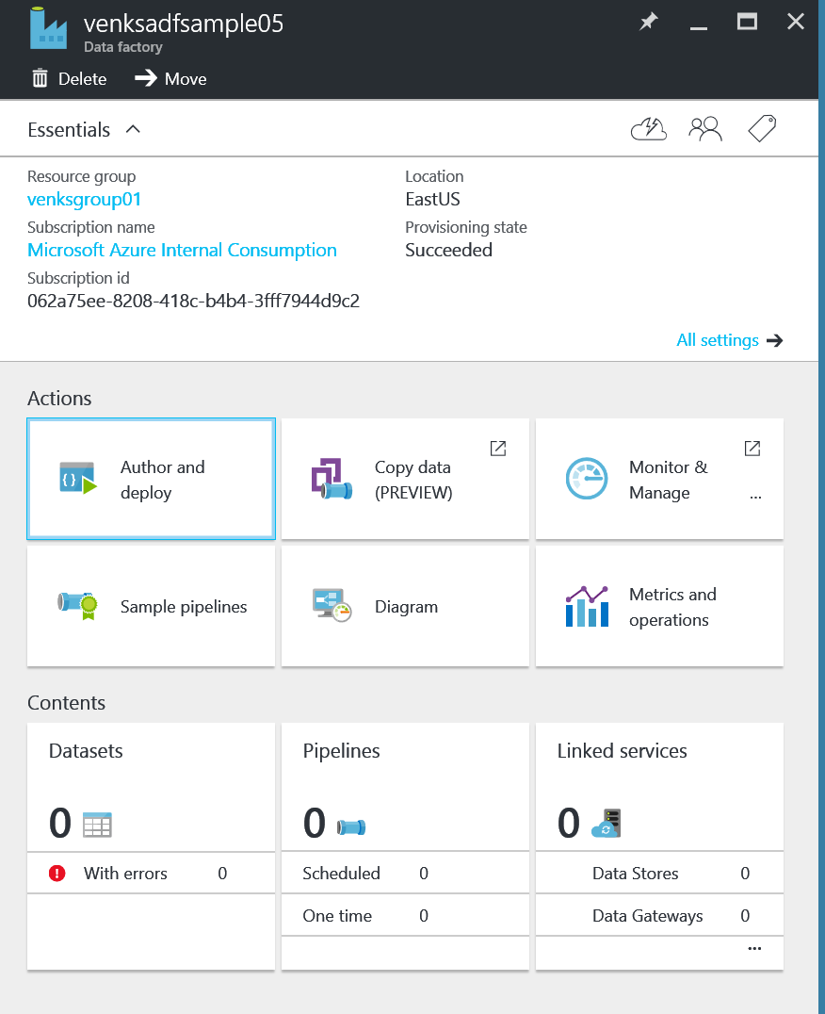
Azure Data Factory – Main Blade

